Slide 1
Zigbee Basic
2019 Jim Lin

Slide 2
Agenda
What’s Zigbee?
Protocol Overview
Physical Layer
MAC Layer
Network Layer
Application Support Layer
Application
Q & A

Slide 3
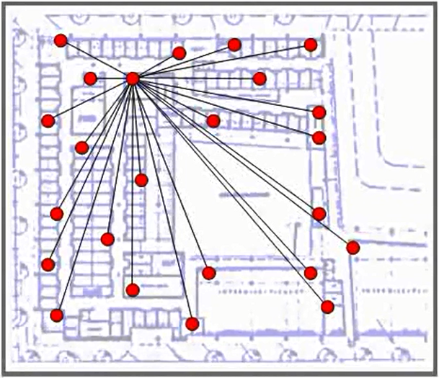
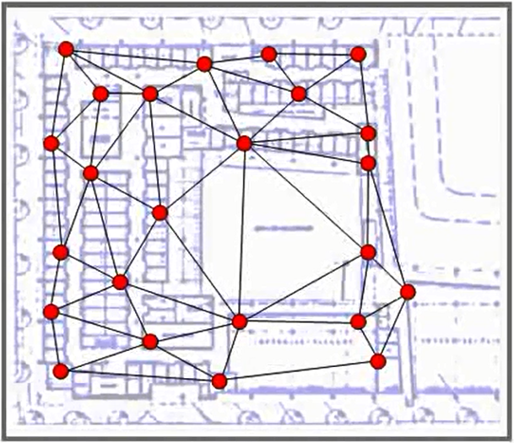
What is Zigbee?
In a mesh architecture, every node can be a router for its neighbors
Network management and data flow is decentralized
Star Network (e.g. 802.11)
Mesh Network (e.g. Zigbee)
Notes:
Embedded mesh networks make radio systems more reliable by allowing radios to relay messages for other radios. For example, if a node cannot send a message directly to another node, the embedded mesh network relays the message through one or more intermediary nodes. Zigbee is an IEEE 802.15.4-based specification for such a network.
A star network, similar to what you would encounter in an 802.11 or WiFi or Bluetooth network, funnels all traffic through a central point. Like an access point. While this makes for a very simple routing implementation with low overhead, it makes the central node a bottleneck for traffic, an essential point of failure for the reliability and messaging in the network. Devices are limited in the ability to communicate as they must talk through the central device even when the source and the destination devices may be right next to each other physically.
By contrast, notice how in the mesh network diagram, each point in the network becomes a relay point for the connection outward to the rest of the network. And one device has potentially several paths to its neighbors. In this kind of ideal mesh network scenario, no one has to be a central point of failure because each node has a redundant selection of links they can rely on to get the message through the network to its destination.
Maximizing their effectiveness in reducing the need for unnecessary devices. By leveraging a mesh network topology, Zigbee networks maximize effective communication range. They reduce the cost of a total solution by not requiring specialized repeaters or central access points and improve the reliability and robustness of the communications.

Slide 4
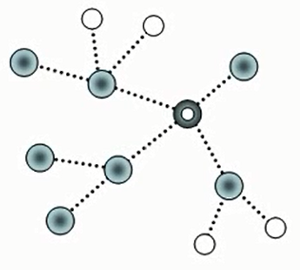
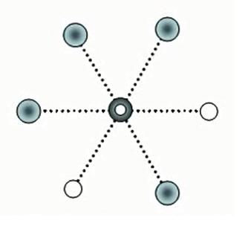


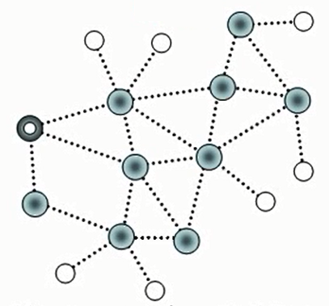
Network Topologies
Tree
Star
Star
Network controlled and initiated by central node (coordinator/hub) in
PAN (Personal Area Network)
End Devices communicate directly with Coordinator
Tree
Tree structure rooted at the PAN coordinator
Note that latest Zigbee specification no longer uses this
Mesh
Messages may be routed from any source to any destination
Every fixed function device can be a router for its neighbors
Multi-hop topology extends range of the network
High reliability achieved through multiple paths
Coordinator
Full Function Device (FFD)
Reduced Function Device (RFD)
Mesh
Notes:
Next lets have a more direct comparison among mesh networks, star networks as well as a tree topology.
Each diagram illustrates how the various nodes of a PAN, a PAN coordinator, a router capable or full function device (FFD) and a few non-routing or reduced function devices (RFD) connect to one another in the given topology. Notice how in the mesh topology, all FFD's have the ability to route to those others within range. Whereas in both the star and tree topologies the nodes opportunities for routing are limited by how the network was constructed originally. In star networks all nodes are obligated to route via the PAN coordinator. In the tree network all nodes must route along the tree links created at the network setup time. In all three cases the PAN coordinator is responsible for initiating the network but only in the mesh topology the PAN coordinator is not necessarily instrumental to the routing of traffic across the network. If the coordinator is removed or temporarily inaccessible, we can see there are a variety of other paths that messages could take to get around the coordinator to reach the destination. This kind of redundancy in decentralization makes for a much more scalable network architecture with long-term reliability and adaptability.
Note that the latest Zigbee specification no longer uses the Tree topology. It is mentioned here only for the topology concept but we will not refer to it again for the rest of the training module. A modern Zigbee network is considered a mesh network, unless it has only one FFD and a number of RFD, in which case it is a star network.
The multi-hop mesh networking capability distinguishes Zigbee networks from other non-mesh wireless topologies.

Slide 5
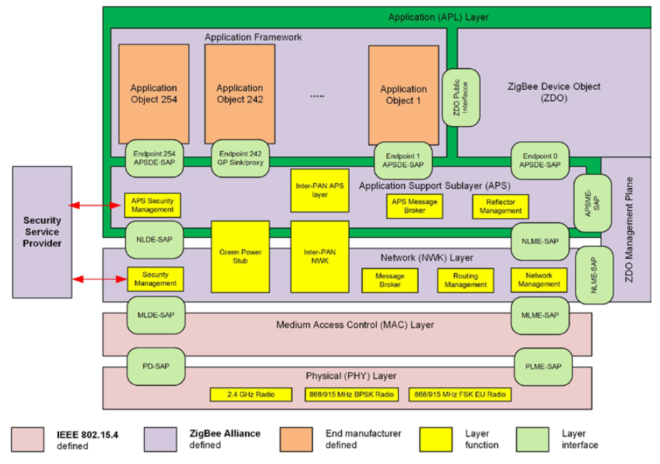
Overview
802.15.4 spec
www.zigbee.org
UG103 series

Slide 6
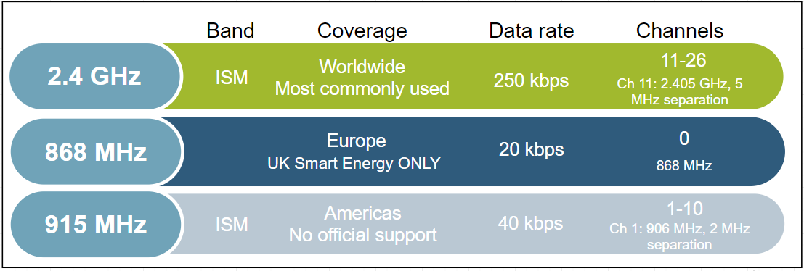
Physical Layer
Interface between physical radio and MAC layer
Radio On/ Off
Modulation / Demodulation
Channel selection
Link quality estimation
Energy detection
Range ~ 2 km line of sight
Notes:
Physical layer handles the transmission and reception of raw bits of data.
The PHY layer uses binary phase shift keying (BPSK) in the 868/915 MHz bands and offset quadrature phase shift keying (O-QPSK) at 2.4 GHz. The information is coded onto the carrier with direct sequence spread spectrum (DSSS), an inherently robust method of improving multipath performance and receiver sensitivity through signal processing gain. Note that 2.4 GHz is the most commonly used frequency band for Zigbee communication worldwide. The only official sub GHz support is for UK smart energy.
Output power:
802.15.4 is designed for low power, low data rate networks with a low-cost objective in mind. These are generally referred to as PANs or Personal Area Networks. The idea here is that these would be low to moderate radio range application designs. But amplification is also possible. It is possible to get up to roughly +20 dBm output power in most countries. In Europe it is regulated a little bit lower to around +10 dBm. But, that's enough to get you anywhere from about one to three kilometers, depending on what your link budget is and what kind of amplification you have and/or what kind of antenna you have.
Data rate:
The raw bit rate is 250 kilobits per second using the 2.4 GHz direct sequence spread spectrum Phy or DSSS. In the real world you are going to see about a quarter or fifth of that. The expected throughout is comparable to a 56k baud modem. Around 52700 kilobits per second on a single hop link. Once you put in multi-hop effects, things will take a little bit longer to propagate.
Open field range
With 2.4 GHz PHY, the ranges we mentioned could be roughly two kilometers with line of sight. This is with a fair amount of amplification and still within legal limits in most areas. And because of all the channels, you have robust communications such that you can avoid interference by making sure to pick channels that are not terribly noisy. Now if you do pick a channel and it becomes noisy, ZigBee has a high level response with what they call "frequency agility." So that some network manager can move the network to a different channel. The other advantage to the 2.4 GHz spectrum is that it's available globally which means you have a wide range install base for your product.

Slide 7
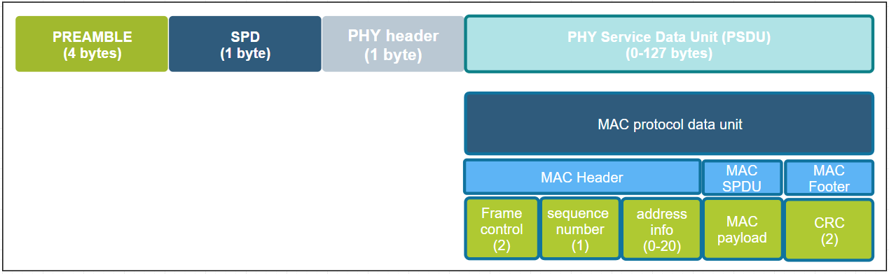
MAC Layer
Takes care of 1 hop communication and acknowledgements
Verifies integrity of packet using CRC
Uses data from the physical layer to sense activity and randomize message transmission (CSMA – CA)
4 MAC Frames
Beacon
Data
ACK
MAC Command
Notes:
We will be moving on to the MAC layer now.
The main function of the MAC layer is to ensure reliable one-hop message delivery by verifying the checksum and sending one-hop acknowledgements. The MAC PDU is shown in the picture. Here are some more details on these functions.
CSMA CA
802.15.4 allows for multiple networks to be on the same channel. Therefore there needs to be some way to avoid having packets from different networks collide over the air and cause errors in communication. MAC sub-layer controls access to the radio using CSMA-CA (Carrier sense multiple access with Collision avoidance). Collision avoidance is done by CCA (Clear Channel Assessment). Before transmitting, every node shall check to see if the airwaves are clear (RSSI below CCA threshold). If they are, the node shall go ahead and transmit after a small random backoff. If the CCA does not pass, then the node shall wait a number of back off periods before trying the process again. The random backoff allows multiple nodes to stagger transmissions so at some point they can find clear air to transmit. Although the bit rate is low, since packets are small (128 bytes), each node completes its transmission successfully even if the channel is fairly busy.
Acknowledgements:
MAC layer also provides a method for nodes to know that 1 hop unicast transmission have been successfully received by way of acknowledgements and that the integrity of the transmitted message has been preserved by verifying a CRC.
Multi hop transmissions shall be acknowledged on every hop. After the node performs the CCA check and transmits the message, it waits for a MAC acknowledgment. If it does not receive one, the node shall attempt to resend the message multiple times until it eventually succeeds, or the maximum retries have been exhausted. The Silabs Ember ZNet stack provides additional mac retries providing earlier corrective action for a failed message transmission instead of waiting until an end-end retry to kick in, which could take several seconds.

Slide 8
Network Layer
Basic Concepts
Node Type
PAN ID
Extend PAN ID
EUI64 / Long Address
Node ID / Short Address
Network Security
Message authentication
Encryption
Replay Attack Protect
Network Key Update
Network Activities
Form network
Join network
Rejoin network
Leave network

Slide 9
Node Types
ZigBee Coordinator | ZigBee Router | ZigBee End Device
There can be only ONE! | Message routing | Leaf nodes
Always 0x0000 | Can also serve as end devices | Can be sleepy devices
Trust Center, Network Manager | Cannot be sleepy | Has parent
Acts as Router | Lives with the network | Parent responsibility
ZC
ZR
ZED
Notes:
Now we can talk about some Zigbee concepts.
First Let’s start with node types.
ZigBee has three types of basic node types. They are: the ZigBee coordinator or the ZC, the ZigBee router which we abbreviate as ZR, and the ZigBee end device - the ZED. The differences among these types of nodes or devices mainly come down to how they interact with other nodes in the network.
First we have the ZigBee coordinator. The coordinator is the most important part of the Centralized Zigbee Network. Only one coordinator is allowed per Network. It is the node that form the network. The shortID of the coordinator is always 0x0000.
Senondly we have Routers, they can relay messages from other nodes. It can not fall asleep. Usually it’s powered by a main supply. These devices should be planned to be powered as long as we want the network to function.
End devices are devices that don’t participate in any routing. The only concept of routing that they have is to send things to their parent or get things from their parent. When I say parent I mean there is some router node, potentially the coordinator, that is responsible for that end device, so it bears the responsibility of forwarding messages out and proxying messages in for that end device. An end device relies on its parent for communication to the network. If that communication is lost, the end device then has to go out and find a new parent, and re-attach itself to the network through this new parent.

Slide 10
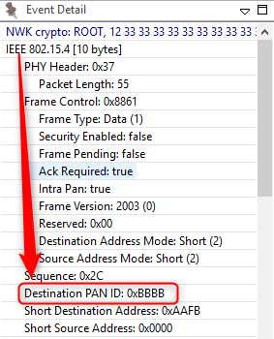
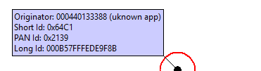
Addressing in Zigbee: PAN ID
PAN ID – Personal Area Network Identifier
Identifies the network
MAC layer filters messages meant for the network
Coordinator picks a random value
Should be unique but conflicts can happen
Stack resolves conflicts -> xPAN ID
Notes:
The PAN, or Personal Area Network, is separated from other networks through its PAN ID. This is a 16-bit identifier that all nodes in the same PAN will share. So it’s something akin to a subnet mask in the Ethernet world in that you generally would only be communicating with devices within your local network, which is the PAN in this case. This identifier is placed into the low-level MAC-layer header in every out-going packet, and it allows devices that receive the packet to filter out the messages that don’t pertain to their network. They can compare it against their own PAN ID, and decide if this is a message from someone in their own network, or if it’s from someone in a different network that just happens to be on this channel so there’s no need to try to decode or decrypt it.
The PAN ID is chosen by the coordinator upon network formation. Because the PAN ID is the distinguishing factor between one network and another, it should be random to unsure its uniqueness. It’s recommended that you select a random 16-bit value for your PAN ID that keeps your network from coinciding with any other network that happens to exist in the area.
Now, what if you happened to pick a PAN ID that’s already used by another network? Or what if you did pick a random PAN ID that wasn’t in conflict with any other network, but later another network grew to overlap with yours? If the PAN ID conflict ever happens, the stack can in fact detect such a conflict and can update its PAN ID automatically and inform all the nodes in its network to move to the new PAN ID, so that each node can continue communicating with nodes in its original network and exclude anyone on the conflicting network. You may be wondering how the stack does this.

Slide 11
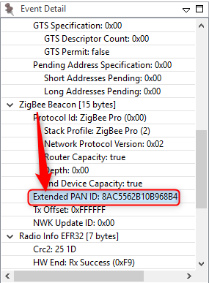
Addressing in Zigbee: Extended PAN ID
Extended PAN ID
Unique per PAN
64bit ID
known to all nodes in the PAN
Randomly generated by Coordinator at time of network formation
Only sent over-the-air in response to active scan.
Enhances network selection
PAN ID changed? Still recognize the network
Conflict results in unusable network
Notes:
Well, it is done through the use of the extended PAN ID, which is another network identifier known by all nodes in the PAN.
While the normal short 16-bit PAN ID is transmitted over the air in all the packets because it’s short and simple, the 64-bit extended PAN ID is rarely transmitted over the air. The extended PAN ID is also unique for every PAN, and it’s basically used as a backup criteria when the 16-bit PAN ID is not enough to always distinguish one network from another. For instance, when a PAN ID conflict occurs and you want to notify all devices in your network to move, the way that you distinguish your network from the conflicting network is, those devices in your network all share the same extended PAN ID. The extended PAN ID is highly unlikely to ever conflict because it has 64 bits compared to the 16 bits in the short PAN ID.
The extended PAN ID is also chosen by the coordinator during network formation. It’s only sent over the air in response to an Active Scan when nodes are soliciting the network, or when a PAN ID update is occurring.
It’s also a useful factor in allowing you to select the network. If you are trying to come into a network rather than form one, you might wonder how to tell which networks are available. The way the networks are distinguishable from one another is not only in the PAN ID but also in the extended PAN ID. You might want to do something special where you decide you are only going to use a certain subset of extended PAN IDs so that you can distinguish your networks from other networks, but just don’t limit yourself too much, because the more you limit this the more likely that you have a conflict, and if your extended PAN ID ever conflicts there’s really nothing you can do to fix that. It’s a little like a WiFi SSID, except that those can be the same between networks and this one can’t.

Slide 12

Addressing in Zigbee: Node ID
EUI – 64 address aka LongID / IEEE address
Assigned during manufacturing
Should be unique in the world.
IEEE assigns ID ranges to companies
Standardized to 64 bits
Can be changed at the cost of loosing uniqueness
Example ID
Network Address aka. Short ID/Node ID
Randomly chosen during runtime.
Can be conflicting
Resolution based on LongID
Size 16bits
Should be unique in the network to avoid conflicts
Example ID
Notes:
Besides their network-wide criteria, one node is distinguished from another by its individual node addresses.
A node has a short address and a long address. The long address is the IEEE-assigned MAC address, or EUI-64. It is a 64-bit address that is globally unique, meaning no two IEEE-based radios in the world should ever have the same EUI-64. This is generally assigned at manufacturing time. They are assigned when the chips come out of our manufacturing facility before they arrive to you, and they will never change. That’s how you tell one radio from another. But because 64 bits are a lot of data, this long address is not sent over the air very often.
Most of the time the much shorter, 16-bit address is used over the air. This is known as the node ID and unique within a network, similar to an IP address in Ethernet world. It is assigned as the node enters the network, and it’s supposed to be unique within that network. There may be two networks each of which has a node with the same node ID, but because they in different PANs, it doesn’t matter.
Note that it’s possible for two nodes to have chosen the same random node ID when they enter the network. If that happens, much like the PAN ID scheme, there is a method for conflict resolution. When the nodes notice the conflict, based on the EUI-64 information as a fallback, they can agree upon new addresses. So the nodes can change addresses at run-time if required, based on a conflict.
In addition to addresses of the node, there are also concepts of addresses within the node these are Endpoints and Clusters and they are explained in the “Clusters Endpoints Devices” training module.

Slide 13
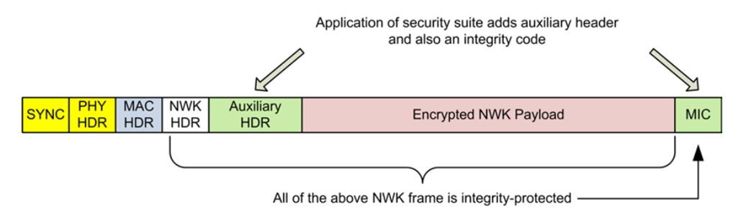
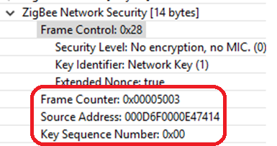
Network Layer Security
All nodes share the same network key
Hop-by-hop security
Source Address: Who encrypt the message
Replay Attach Protect
Will increase after sending message
Frame Counter: MUST be bigger than last received
Network key will be updated periodically

Slide 14
Creating a Network
ZC starts the network by choosing a channel and unique 16-bit PAN ID and 64-bit Extended PAN ID.
ZR or ZED joins the ZC.
ZR or ZED joins the ZR. (ZR becomes the ZED’s “parent”.)
Network grows outward from ZC.
Notes:
Let’s begin with where the network begins, and that’s about creating a network.
When a Zigbee network starts, it all begins with the Zigbee coordinator, the ZC. This is shown in our diagram here. The ZC is represented by a thick red circle, the thin red circles are routers, and the thin blue circles are end devices.
The coordinator begins by choosing a channel that would be one of the 2.4 GHz allocations designated 11 through 26. These represent channels with a center frequency from 2.405 GHz all the way up to 2.480 GHz. Then the coordinator is responsible for choosing a unique 2-byte PAN ID as well as a unique 64-bit extended PAN ID. If you recall from our last presentation regarding PAN IDs, the short PAN ID is generally used to divide the network, but in case a conflict arises the extended PAN ID is our backup scheme.
Once the coordinator has chosen the channel, PAN ID and extended PAN ID, the network grows by allowing more nodes such as a router or an end device to join through the existing coordinator. The basic idea here is that a device can’t get into the network except through a node that is already in the network. The exception, of course, is the coordinator who has this special property of being able to form the network without having to get permission from anyone.
After the first router joins the coordinator after network formation, future nodes can join the network through the coordinator or the new router. They cannot join through the end device because an end device doesn’t have the ability to route. As the network grows we start to form a tree-like structure that builds out from the coordinator, with the end devices generally being on the fringes of the network.

Slide 15
Joining a Network
New ZR or ZED scans channels to discover all local (1-hop) ZR or ZC nodes
PAN ID/EPID, Stack Profile, Joining Allowed sent back to scanning node.
Scanning device chooses a responding device and submits a join request
If accepted, the new device receives a confirmation that includes the network address.
Notes:
From the perspective of joining a network - suppose that your device who wants to come into the network is embodied by this purple circle, neither red nor blue yet because it hasn’t actually joined the network and it doesn’t have a node type yet.
First of all the device has to scan across the channels, to decide what networks are available. Then it has to solicit router and coordinator nodes to determine what networks are there, and which are available devices through which it can join. This process is called an Active Scan, an IEEE 802.15.4 MAC concept where we send the beacon request which is a single hop broadcast that transcends all the PAN ID boundaries. Every device in every 15.4 network within range can hear this beacon request, and they are supposed to respond with some indication of their network such as PAN ID, extended PAN ID and stack feature set, and a Boolean parameter that says whether or not there’s any joining allowed. This “joining-allowed” property is done on a case-by-case basis for each node. So it may be that there are two nodes in the available network but only one of those nodes is actually allowing new devices to enter. It’s something like having multiple access points into the network where they can be enabled or disabled for accessibility to new devices at will. The other information that’s not displayed in the diagram here is that there is also information from the router or coordinator about its ability to sustain additional end devices. So if you are an end device wanting to join the network, a potential parent might say it could let you into the network if you were a router, but because it can’t support any more end devices, it can’t let you in. This allows the end device to rule out that node as a potential parent.
In this diagram, in action number 1 we see the large arrow soliciting the devices with its beacon request, and the individual network indications are beacons coming back. Whichever beaconing device is heard best becomes the parent node of the joining device. Once this is chosen, the joining device submits an association request to the chosen node from the chosen network. This is action number 2 – the arrow going across to the chosen device. At this point there is no security authentication; it’s simply that if someone submits a join request to a node and it is permitting joining, and it is able to accept a new device, then it should create and send a random address to the joining device, and now the new device is successfully associated into the network. This is shown in action number 3. This process of association is really a very simple one-to-one device process and doesn’t involve contact with other nodes. After the association takes place there is a security authentication step with the trust center device to complete the story, however we will not go into that.

Slide 16
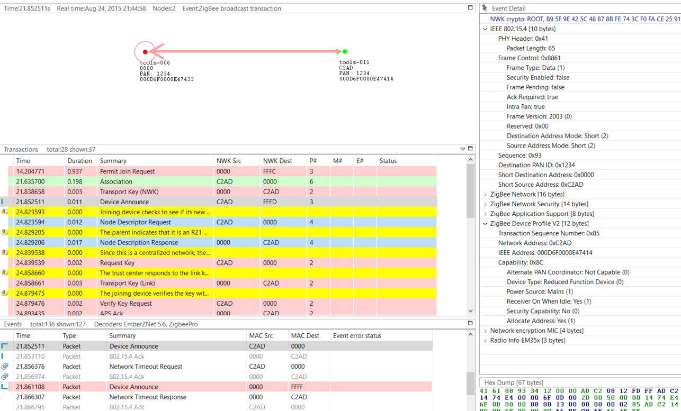
Network Analyzer Capture of Joining a Network
Notes:
This is a log of the Network Analyzer to help illustrate the joining process. If you are not already familiar with this tool, we recommend that you take the time to learn about Network Analyzer.
On the top, you see a visual representation of the network, and the arrows showing the transaction between the nodes. The “Transactions View” shows all the transactions between nodes, the “Event View” showing all the messages separately, this is a bit overwhelming because the message of a transaction can be scattered over time. The “Events detail” view is showing the different fields inside the selected message in the “Events View”. More information about the Network Analyzer will be handled in the “Studio: Key Concepts Network Analyzer” presentation.
The joining device sends an association message to the coordinator of the network, this the green message in the log. After this the coordinator will share the network key, so the device can encrypt and decrypt the messages. After this is done the joining device is announcing itself in the network, this way the whole network knows what kind of device the just joined device is. The details of the device announcement can be seen in the “Event Detail pane” on the right. Here we see in the top red box the PAN id of the network, also here is the short Id of the joined device visible. The following 2 red boxes are more device describing, from these boxed you can determine the device type, coordinator, router, end device or a sleepy end device. Routers and Coordinators are full function devices, while an end device or a sleepy end device is reduced function devices. For a sleepy end device, the receiver will sleep when the device is in an idle state, while the other devices will always listen to the channel.
After Device Announce, the device then requests a link key update. For further information and more details on link key update, we recommend the “Network Concept: Zigbee Security” and “Zigbee App Layer: Zigbee 3.0 Security Considerations”

Slide 17
Rejoin a Network
Reasons of rejoining
Sleepy end device lost communication with his parent
Devices that have missed the network key update
Devices that have missed a PAN ID update
Types of rejoin
Secure rejoin
Trust center rejoin
Notes:
Rejoining is a way for a node to reconnect to a network of which it was previously part. Rejoining is necessary in three different circumstances:
Sleepy devices that may no longer be able to communicate with their parent.
Devices that have missed the network key update and need an updated copy of the network key.
Devices that have missed a PAN ID update and need to discover the network’s new PAN ID.
When a device tries to rejoin, it may or may not have the current network key. Without the correct network key, the device's request to rejoin is silently ignored by nearby routers. Therefore, a device has two choices when rejoining: a secured rejoin or a trust center rejoin. If the rejoining device has the correct network key it will do a secure rejoin to a neighboring router. A router/coordinator device will always provisionally accept a NWK layer Rejoin command with the active network key. If the network key is invalid the rejoining device is will request a new network key from the trust center, this is called a Trust center rejoin. Note that neither of these rejoins cases requires the MAC Permit Association otherwise the procedure it the same as the Association procedure.
Let’s look at the bottom picture, this is part of a log from the Network Analyzer, where a device is sending a rejoin request to the coordinator. The coordinator is granting the device access to the network with a network response command. The message after this is a device announcement, this is used to notify that the device is on the network.
For more detailed explanation we recommend the “Network concept: Zigbee Security” and “App layer: Zigbee 3.0 Security Considerations”

Slide 18
Leaving a Network
Leave Request
ZDO Leave
Direct (to router, or to end device)
Indirect (to end device’s parent with end device EUI as target)
APS Remove Device
Leave Announcement
As a result of Leave Request by another device
Voluntary Leave
Example Use Cases
Coordinator indicates a device to leave the network
Device voluntary leaves the network and announces this
A router wants his child to join another router.
A router is asked to leave the network as well as his children
Notes:
Now we have talked about forming, joining and rejoining a network, let’s now start talking about leaving the network. There are multiple ways to request a device to leave the network. You have the ZDO leave command which can be indirect or direct. With the indirect way we request the parent of the end device to handle the leave of the end device. This can be useful with end devices. The direct way of a leave request will address the leave request to the device directly. This can be used for routers and end devices. (Note that messages for a sleepy end device may time out before they are delivered.)
APS Remove Device is another way to request a device to leave on the APS layer, this gives you the opportunity to encrypt the message.
If a device is receiving a leave request and then leaves, it sends a leave announcement to notify the rest of the network. This gives the opportunity to the rest of the network to take adequate actions, such as updating their routing tables.
The leave announcement can also be sent to the network as a result of device voluntarily leaving the network; here you can think of it as a graceful power down.
On the right side of the slide, there are some example use cases of leaving a network.
The first one is a coordinator that requests a device to leave the network, this is used for example when the joining process is not successfully completed.
The second use case is a device that is voluntarily leaving the network. There the device is only sending the leave announcement.
The third one is a router that is requesting an end device to join another router; this can be a result of a router leaving the network and allowing its end device children to remain in the network.
The last one is a coordinator that is asking a router to leave the network, as well as its end device children. The router will first request the children to leave the network, and after that leave the network itself.
For some extra information and pros and cons for the different types of Leave commands, see this KBA:
https://www.silabs.com/community/wireless/zigbee-and-thread/knowledge-base.entry.html/2016/07/14/ways_to_tell_zigbee-kfzE

Slide 19
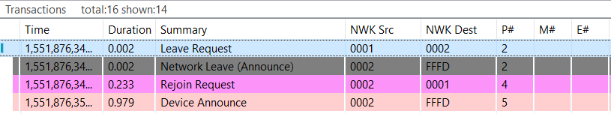
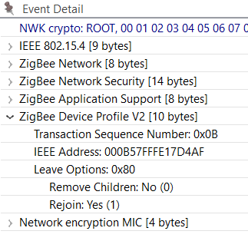
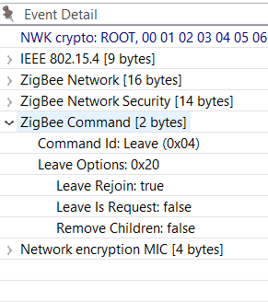
Example of ZDO Leave
Notes:
Let’s see how a network leave looks like in the Network Analyzer. At the top of the screen you see the transactions where a device is asked to leave and then rejoin the network. First, device 0x0001 is requesting device 0x0002 to leave the network. In the lower part of the screen you can see event details on the left side. In the leave request, the Rejoin bit is set to True while the Remove Children bit isn’t set. This message is processed by device 0x0002 which sends a network leave announcement, the event details of which is shown on the right side. In this message we see that the Leave Rejoin bit is set, and other rejoin options are cleared. The “Leave is Request” is set when the device is leaving the network by a request; when it’s cleared the leave is initiated by the device itself. The Remove Children option bit is set when the children of the device are also removed, and cleared when this is not the case.
This completes the leave cycle, but the rejoin bit is set in this example so the device is rejoining the network again. This can be seen in the log, by the Rejoin Request and the Device Announcement message later.

Slide 20
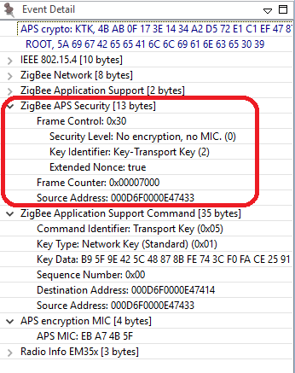
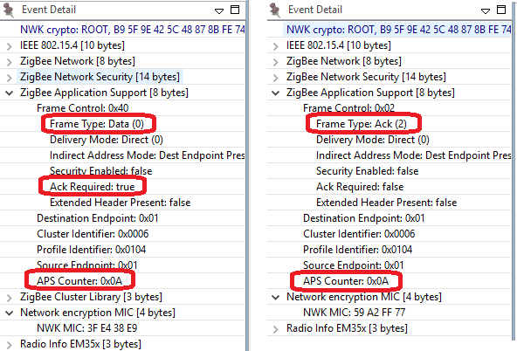
APS Layer
Data transmission
Group / Multicast
End to end retry
Duplicate rejection
Fragmentation
Management
Group management
Security

Slide 21
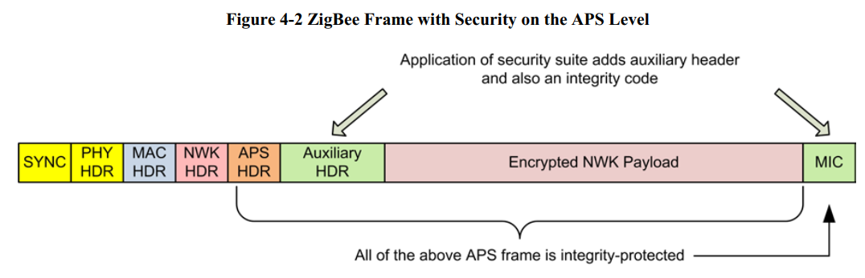
Aps Layer Security
End to end security
Link key:
Trust center link key
Application link key – (SE)
Trust Center: All joining devices must be authenticated by trust center.
TC link key: the link key used between trust center and the device
Global link key: all devices use the same
The well-know link key: ZigbeeAlliance09
Per link key per device
Install code

Slide 22
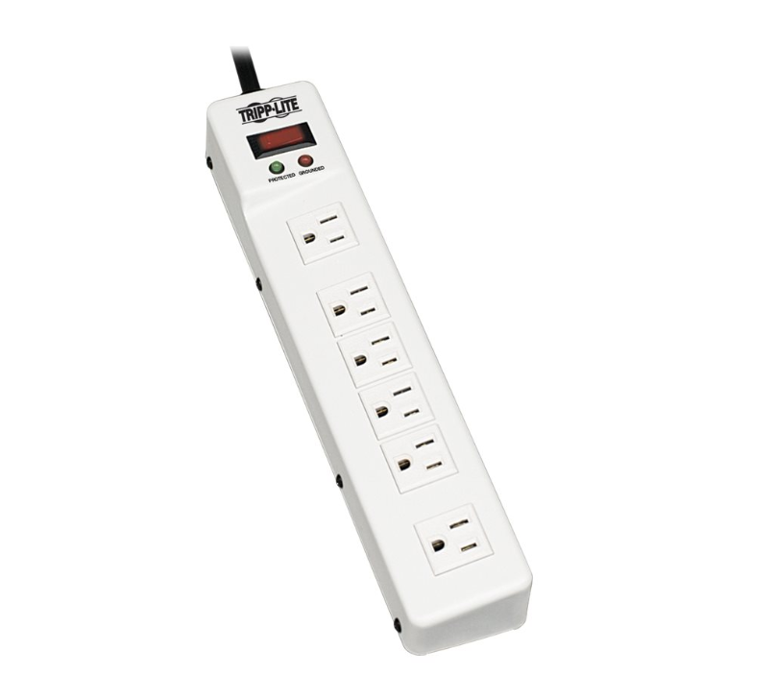
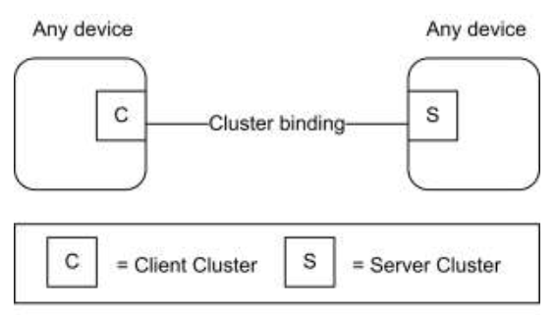
Overview of Application Layer
Endpoint: logical device
Endpoints 1-239 are available for user applications
Endpoints 0, 240-255 are reserved for special functions
Endpoint 0: Zigbee Device Object (ZDO); used for network config/admin
Endpoint 255: Used for Broadcasting a message for all endpoints
Cluster: communication model
Client/Server model
Defined in Zigbee Cluster Library (ZCL)
Cluster ID
Commands
Attributes
Power Strip
Endpoint 1
Endpoint 2
Endpoint 3
Endpoint 4
Endpoint 5
Endpoint 6

Slide 23
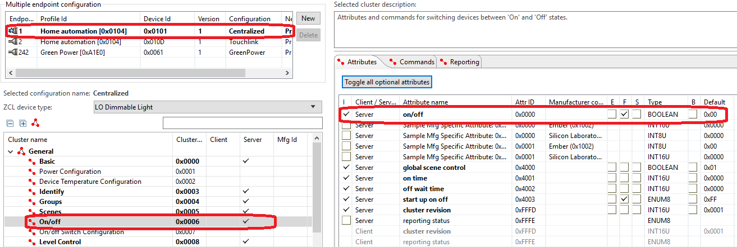
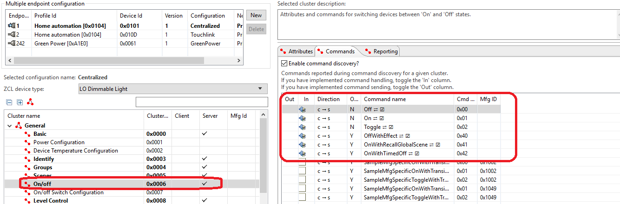
Example of Cluster

Slide 24
Q&A
Q&A

Slide 25
Thank you!
Notes:
Thanks

